Slide 2
Section 7 Sequences, Series and Proof by Induction
Sequences
Series
Proof by Induction

Slide 3
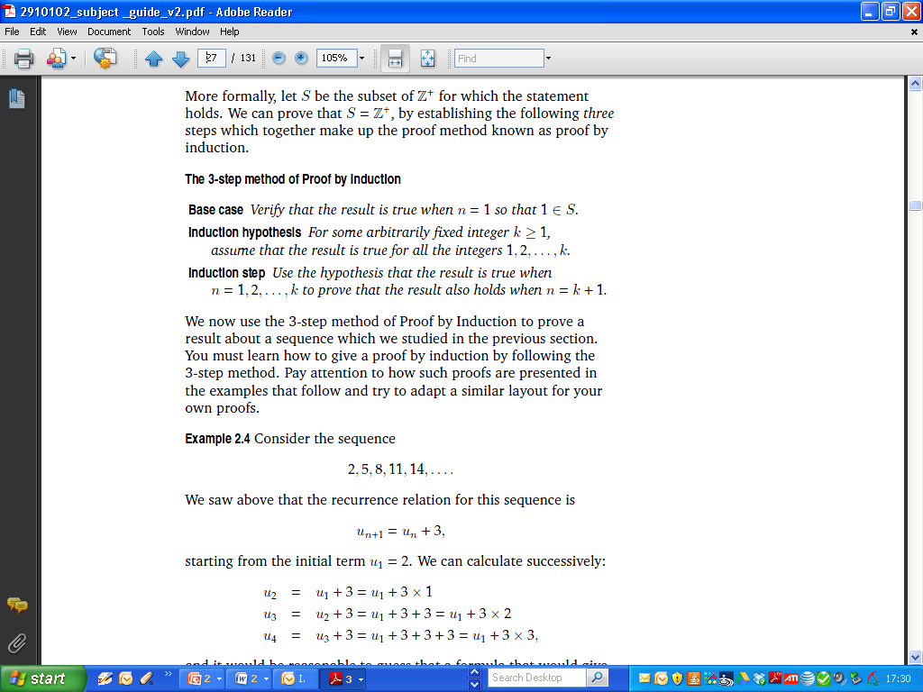
Section 7 Sequences, Series and Proof by Induction
Sequences
Series
Proof by Induction

Slide 4
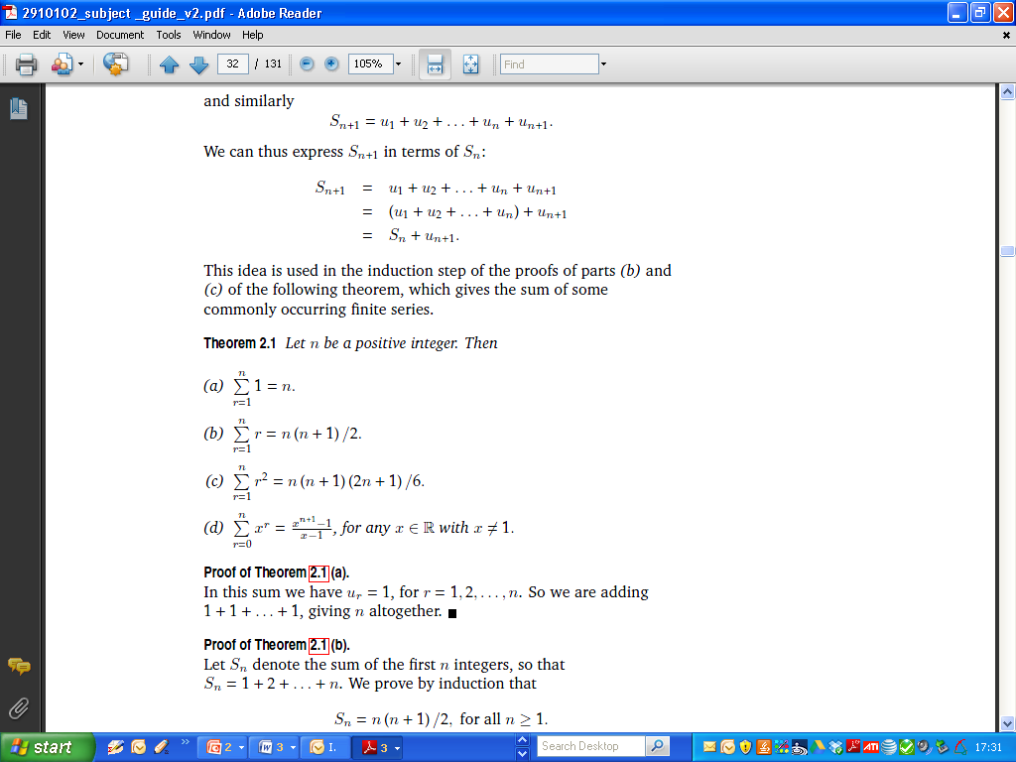
Section 7 Sequences, Series and Proof by Induction
Series

Slide 5
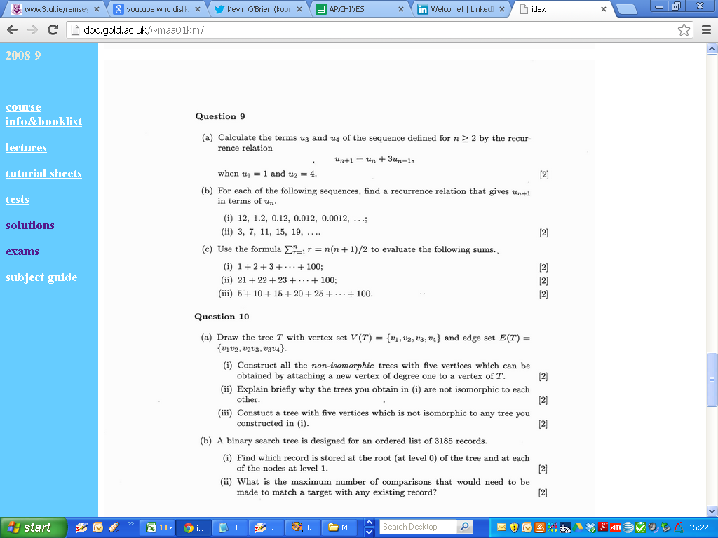
2001

Slide 6
2001

Slide 7
2001

Slide 8
2001

Slide 9
2001

Slide 10
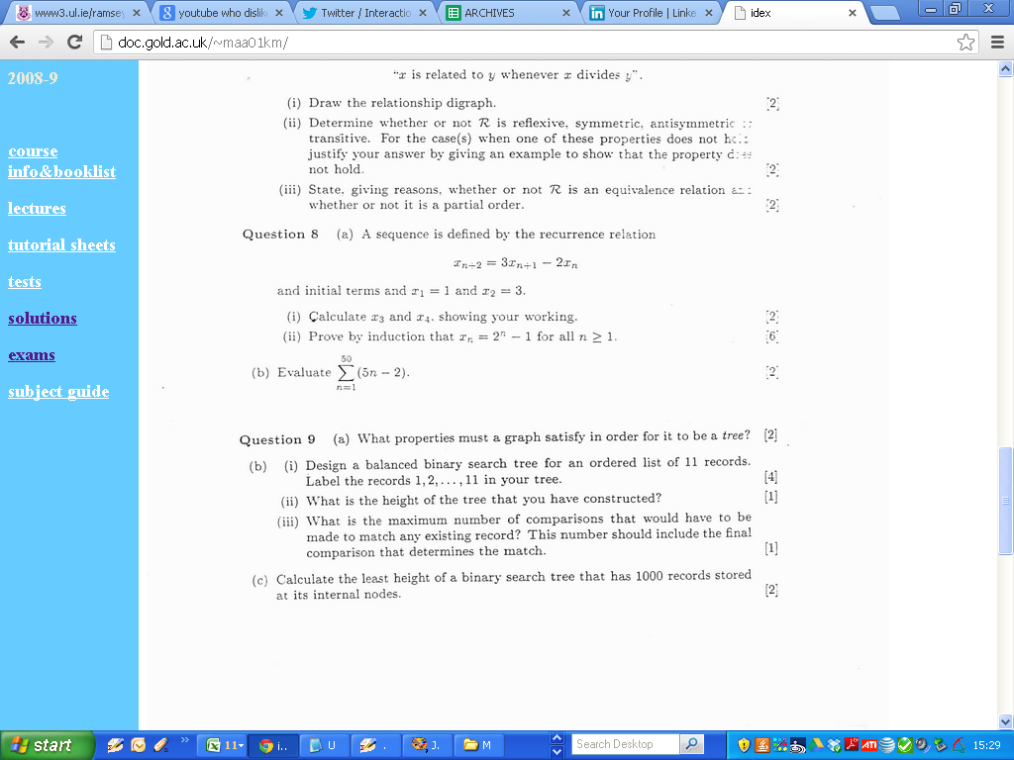
2002

Slide 11
2002

Slide 12
2002

Slide 13
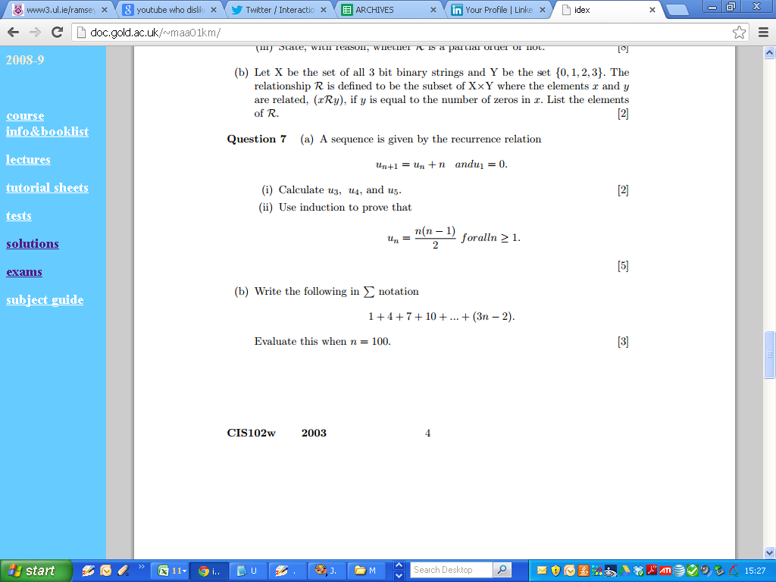
2003

Slide 14
2003

Slide 15
2003

Slide 16
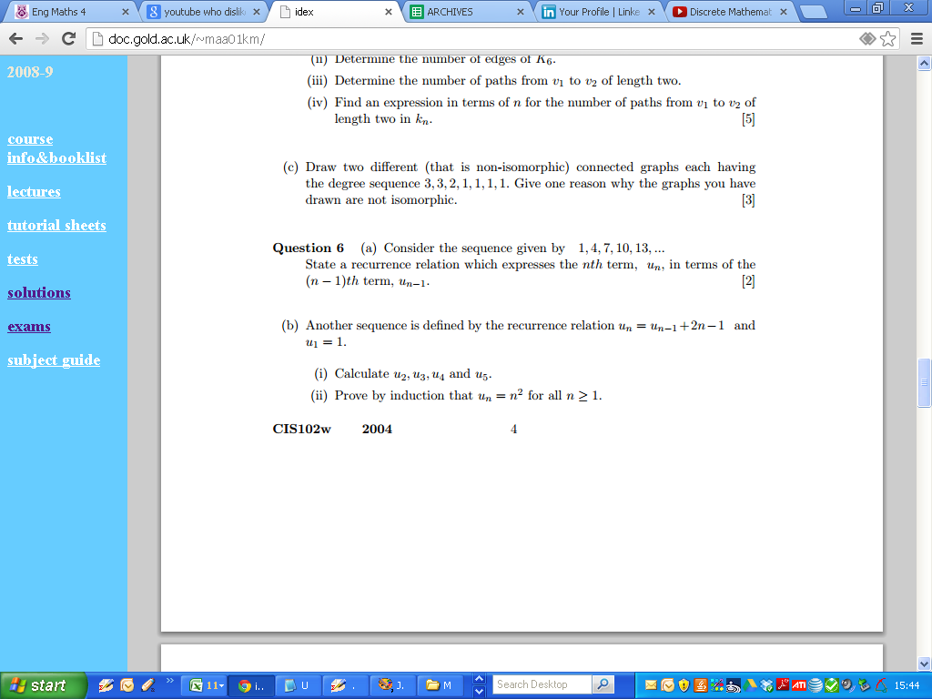
2004

Slide 17
2004

Slide 18
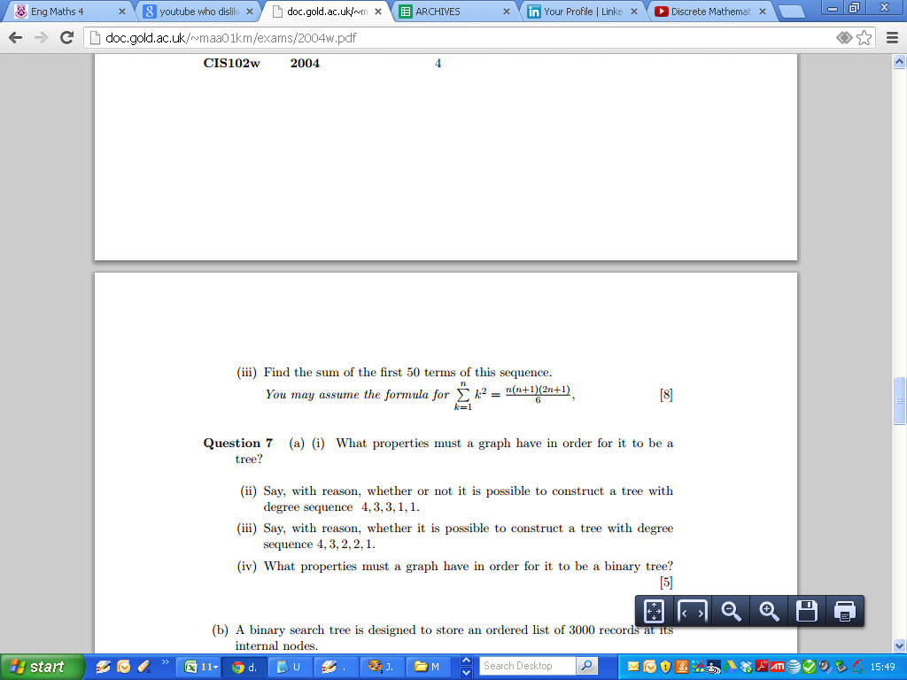
2004

Slide 19
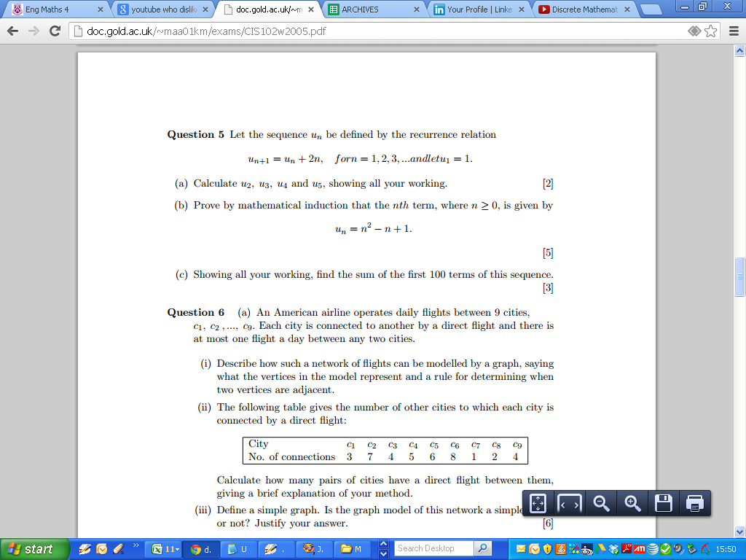
2005

Slide 20
2005

Slide 21
2005

Slide 22
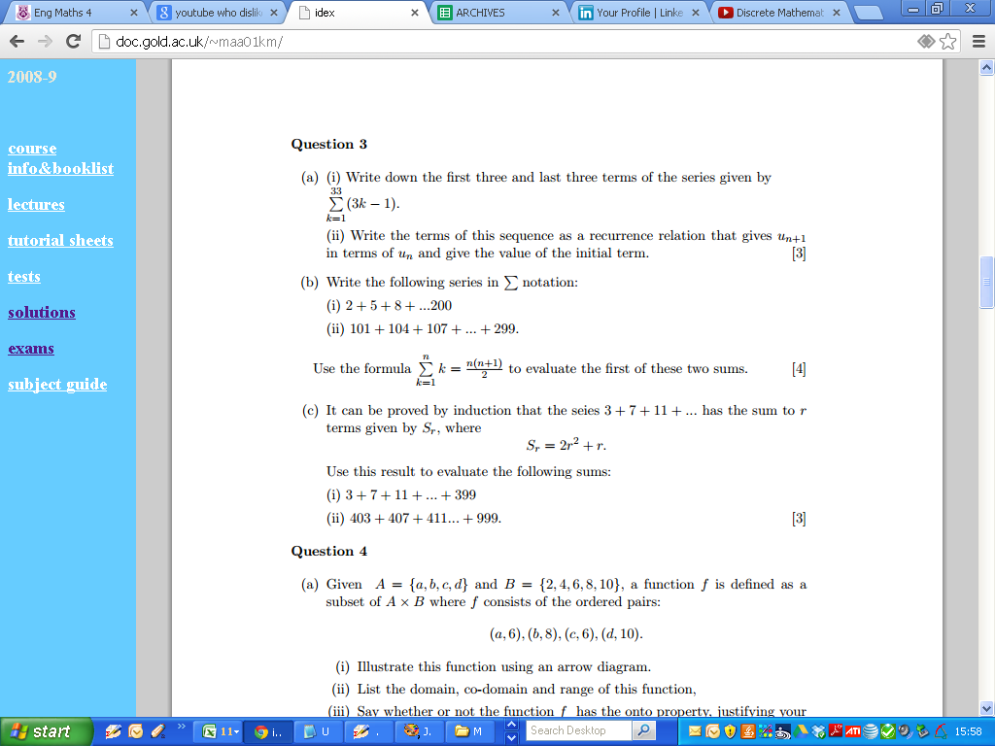
2006

Slide 23
2006

Slide 24
2006

